Slide 1
Restoration Company
Disaster ERP Plan

Slide 2
Why A Disaster Plan Is Important
It’s Not Just About Restoration Work
It’s Really About Your Business Stays in Business! Minimizing Disruption.
25% of businesses never re-open
80% of companies who don’t recover in a month are likely to go out of business
75%of businesses without Business Continuity plans fail within 3 years.
1 in 5 companies spend no time maintaining their plan.

Slide 3
Results of a Disaster Without A Business Continuity Plan
Loss of reputation and/or loss of customers
Loss of revenue
Legality issues
Human resource issues
Increased insurance premiums
Worst case, closure of business

Slide 4
Analogy
Imagine you visited the doctors and the type of experience you would receive if they did or didn’t have all your health history?
Would you get treated better?
Quicker?

Slide 5
What’s In A Disaster Plan
IT
Server
Data Recover
Important Records
Insurance
Contracts
Employee Records
Facilities
Floor Plans
Shut Offs
Vendors
Utilities
Power Resources
Disaster Protocols
Who’s calling who (Phone Trees)
Evacuation
More Than Only Facilities Involved

Slide 6
A Little About Us
Give them info on your organization
History
Certifications
What makes you different - Matterport, Large Scale Drying, etc.

Slide 7
The Old Way

Slide 8
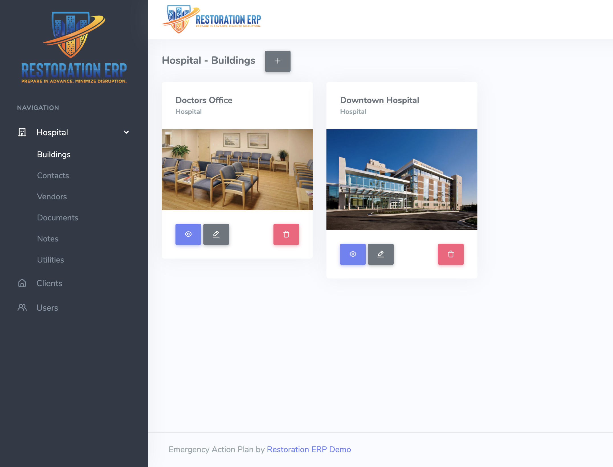
THE New Way
Link to ERP Tool

